Slide 1

“ONLINE JOB PORTAL”
WEBPAGEDEVELOPMENT

Slide 2

TEAMMATES :
SKILL DEVELOPMENT PROJECT : 40
BUSINESS SYSTEM: ONLINE JOB PORTAL
OUR MEMBERS:
2200032666 BATCHALA SAIVIVEK
2200031512 MULAM VENKATA SAITEJA
2200031044 IPPILI SAIMANI

Slide 3

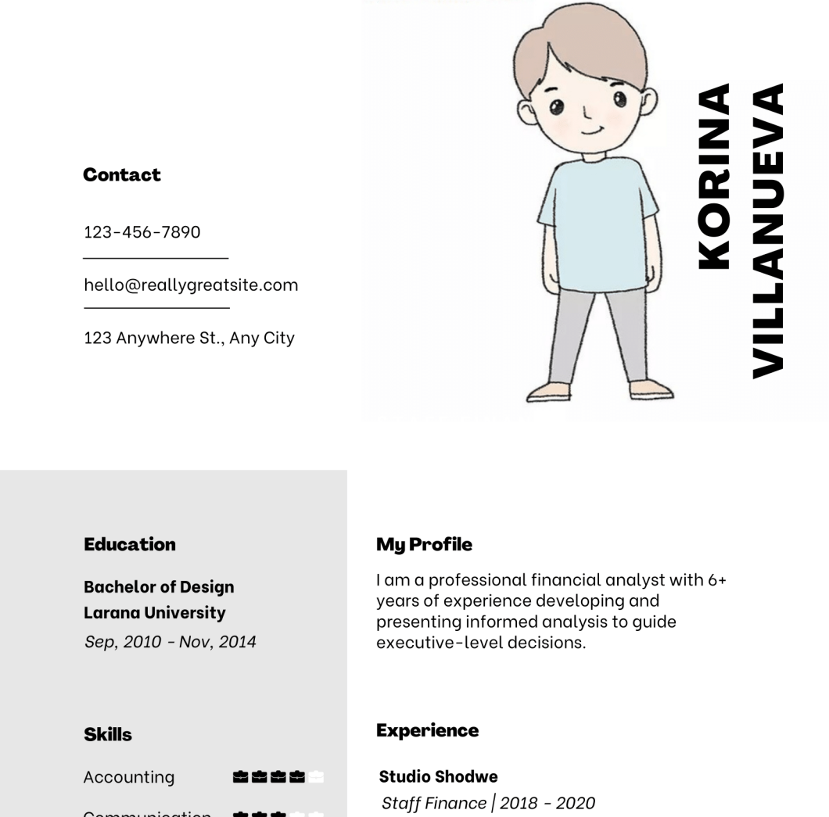
Abstract:
This project revolves around the digitization of the recruitment process, where an online system takes charge of managing and facilitating the entire hiring procedure. The primary objective is to provide individuals with the ability to apply for job vacancies within the company through an efficient and user-friendly online platform. Once registered, applicants are designated as "applied users" and can engage with the system to stay updated on their application status.

Slide 4
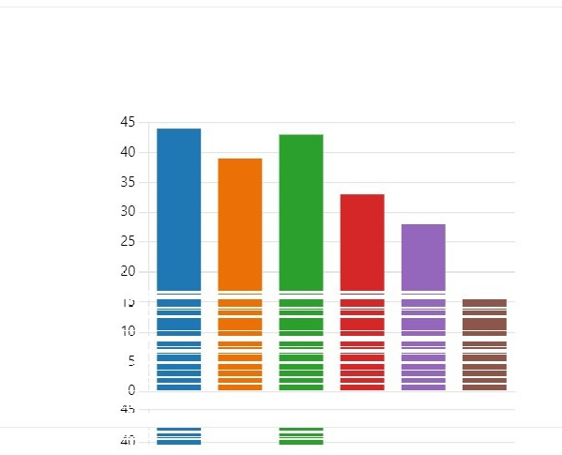
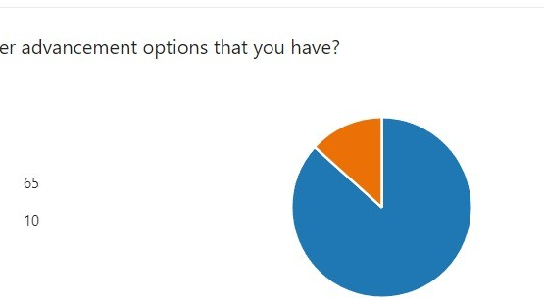
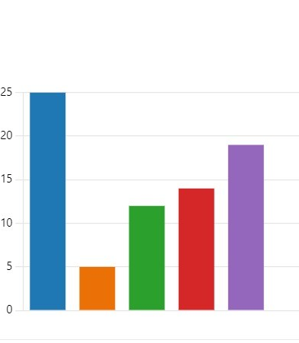
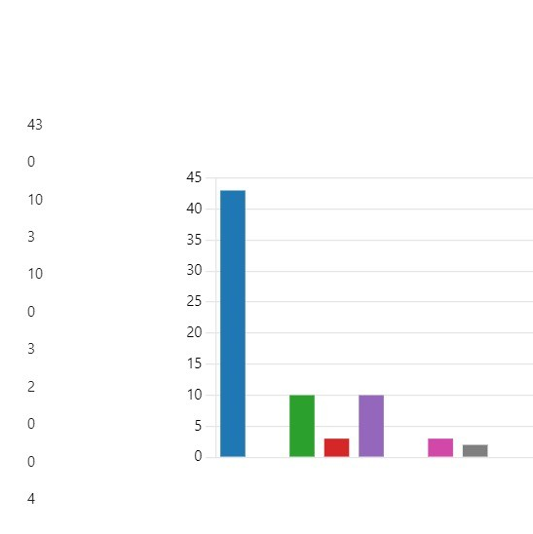
OUTPUTS FROM THE SURVEY:

Slide 5
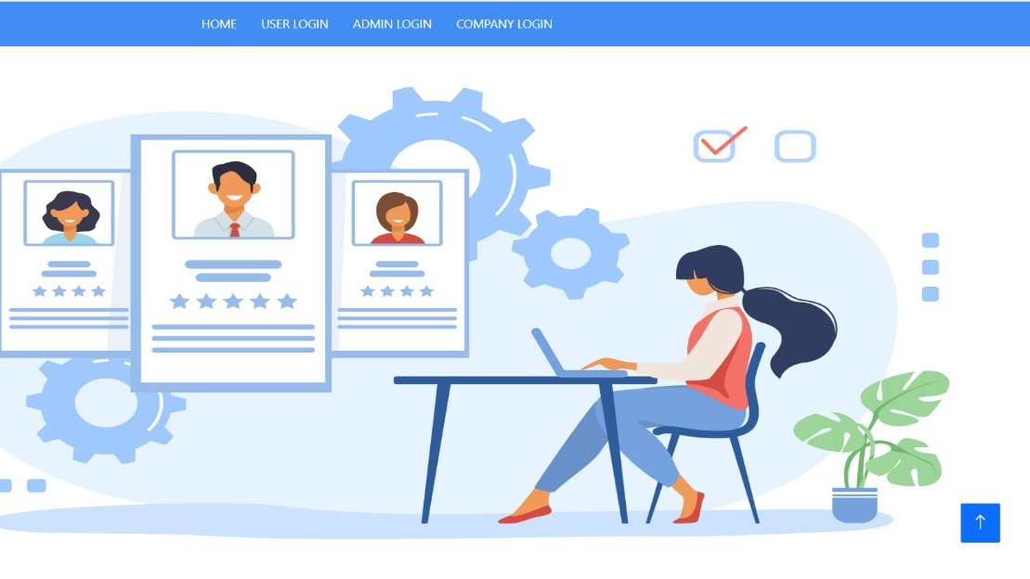
Our Web Application Prototype:

Slide 6
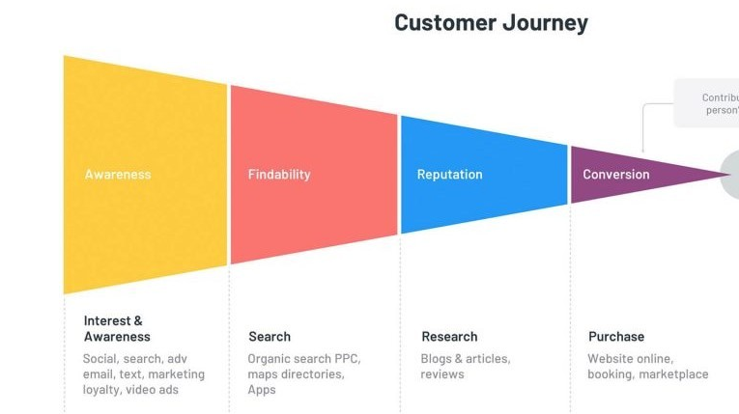
CUSTOMER JOURNEY MAP:

Slide 7
Our SDP-1 Project Web Application Consist Of different Modules:
RESEARCH LINKS :
https://www.thebalancemoney.com/top-best-job-websites-2064080
https://chat.openai.com/
https://jobstas.com/blog
https://www.placementindia.com/blog/
1.Job Posting Module
2.User Account Module
3.Jobseeker Services Module
4.User Applies Module
4.Recruiters Module
5.Application Tracking Module

Slide 8


